Slide 1
Group 1 Project 3 DATA ENGINEERING: creating a restaurant ratings database
Team: Cole O’Neill - Joel Fisher - Justin clawson - Selena Passeno – Zac Williams

Slide 2







Tools used
Python/Jupyter Notebook
Pandas
Pprint
Requests
SqlAlchemy
SQLite
Urllib.parse
PostgreSQL
7zip
Leaflet

Slide 3
Project overview
Collection of restaurant and ratings data from a variety of sources
Cleaning the data
Converting to dataframes, exporting to CSV
Loading to PostgreSQL
Using SQLite to pull data from PostgreSQL into dataframe
Notes:
Name a few of the sources we tried but didn’t work or had to pay

Slide 4
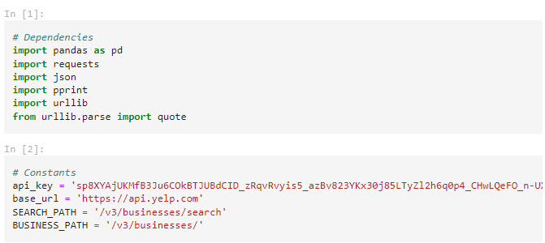
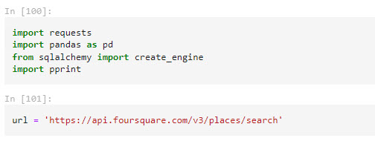
Data EXTRACTION
Sources: Yelp and Foursquare
Tried other sources but ran into issues
Downloaded TAR/JSON data as text into Excel and used the data toolbar to convert text to columns
Used JSON to extract data for several cities

Slide 5
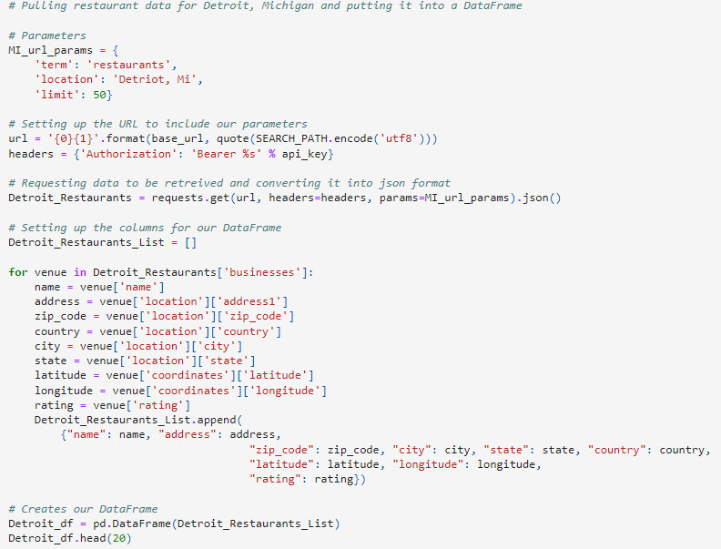
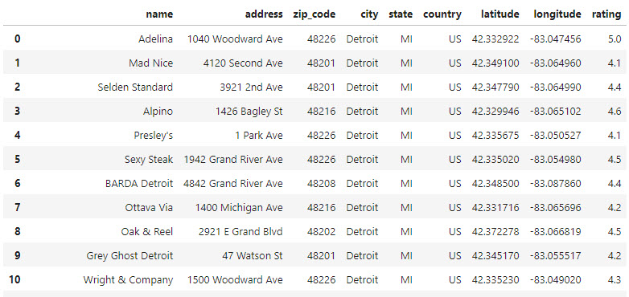
Data Transformation
Set parameters and removed unwanted fields
Ultimately whittled down to 317 items

Slide 6
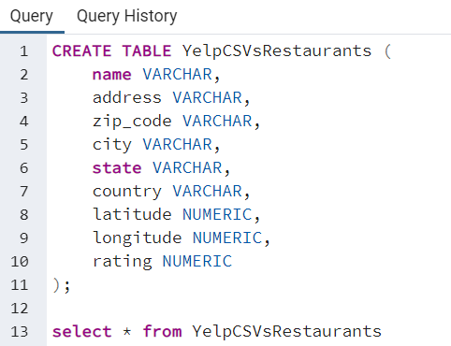
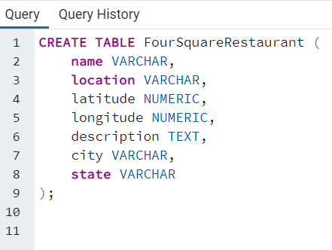
Data loading
Multiple dataframes merged to one each for Yelp and Foursquare and exported to CSV

Slide 7
SELENAS SCREENSHOTS

Slide 8
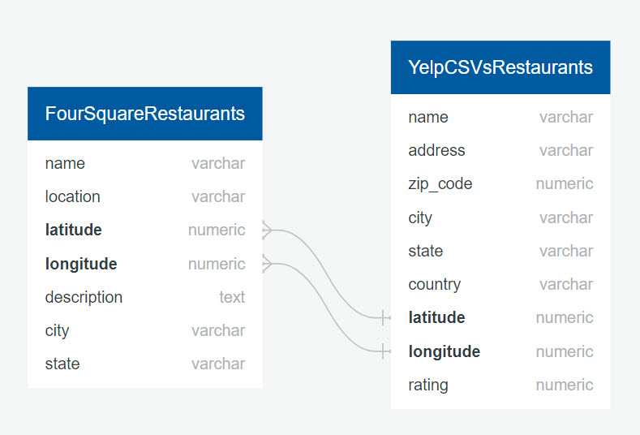
ERD DIAGRAM

Slide 9
Moving sql database to
Multiple dataframes merged to one each for Yelp and Foursquare and exported to CSV

Slide 10
Folium/leaflet map

Slide 11
Ethical considerations
No ethical concerns identified, however some notes about how we handled the data –
Yelp academic dataset is a static file archived 1/19/2022, containing no PII
This dataset is not as current as information pulled by other team members using Foursquare and Yelp API calls
Removed any businesses with rating of less than 3 to reduce size of dataset

Slide 12
Challenges
Data quality issues such as Home Depot being labeled a restaurant because you can buy hot dogs there
Large amounts of data, some intended sources either did not have public data or was behind a paywall
We ended up having to use some more recent data with some less recent data

